Slide 1
LHL SQL Project - Overview
Prepared by Jamie Lepard
Sept 6 2023

Slide 2
Approach
Database purpose:
'what does this db do? what business process does it support?
Relationships:
primary keys and any relationships in tables
Review Master Data tables first
Products, Customers, etc
What elements are important?
Triage the fields to create more digestible views

Slide 3


Slide 4
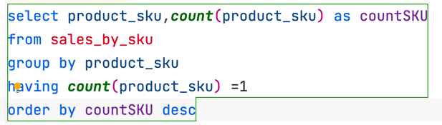
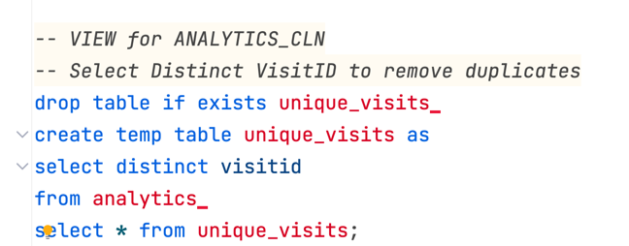
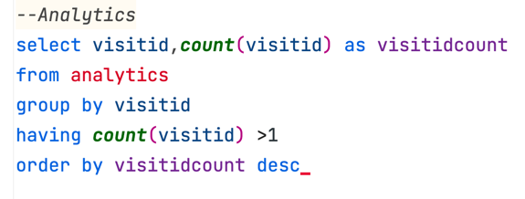
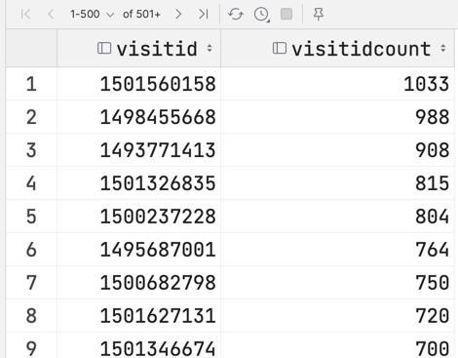
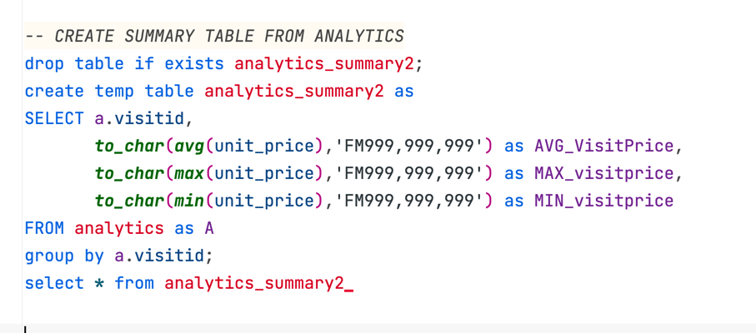
Getting going - initial investigations:
Analytics Table is huge.
All Sessions table is big.
How do they relate to each other?
Whats with these Sales Reports?
Conclusion:
Database is a hot mess. Product info (descriptions, sku, unit cost), order info (qty and calculated fields) are all over the place.

Slide 5
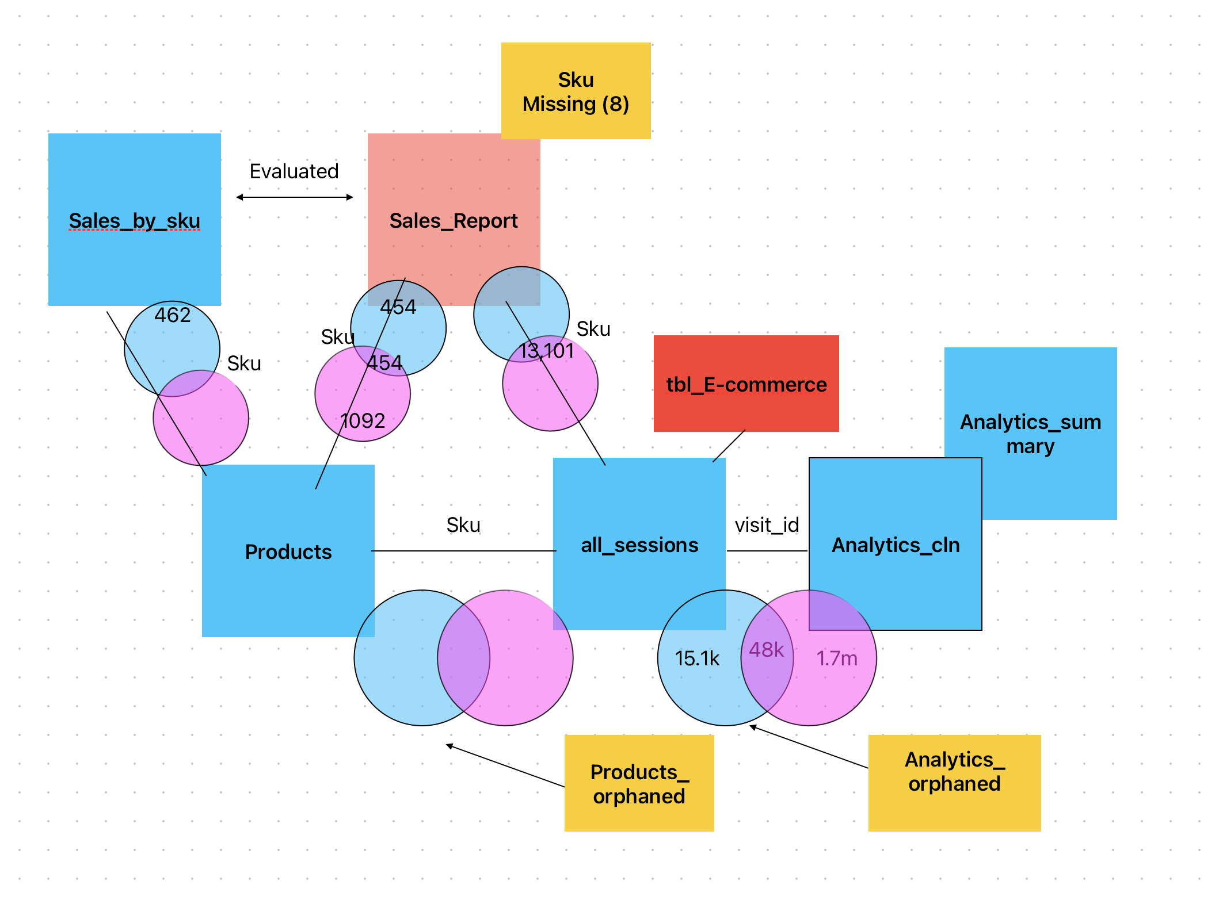
Building Connections….
Reviewed Master Data
Approach to:
Product data in a product table
Session (visit) data in a session table
Analytics (purchases) in a analytics table.
Identify any orphans
Eliminate a redundant Sales Report

Slide 6
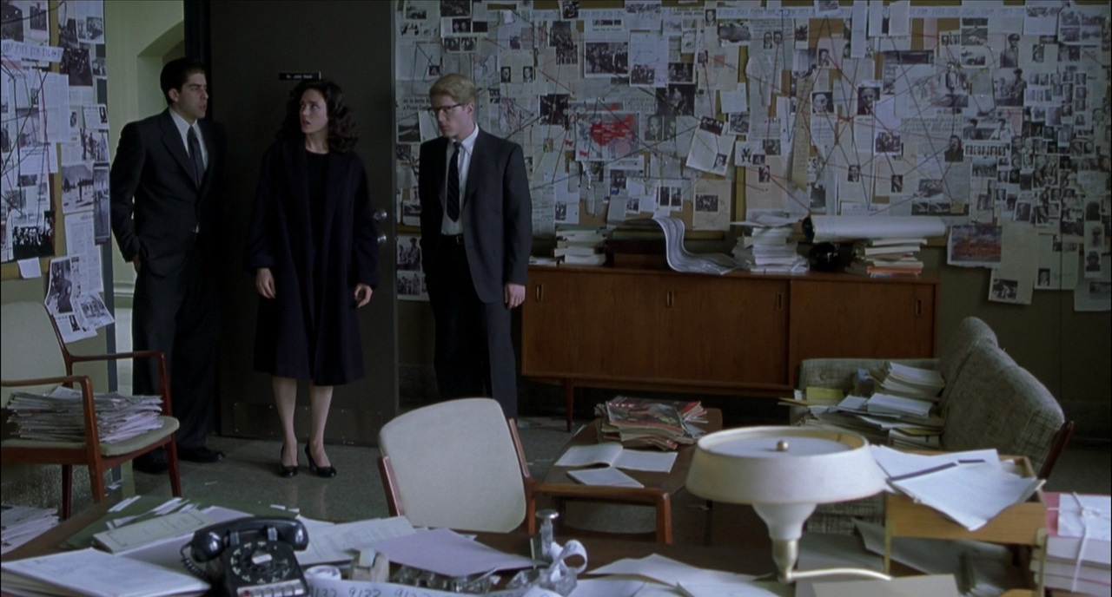

Slide 7
Then it all fell apart
Top Tip!!! Do not create a VIEW in these scenarios!
They have dependency upon each other
Drop/update one and it breaks the others
Quickly becomes on of the circular
Instead make a new Table and append it with .cln (or equivalent)
Primary technical challenge was joining [Analysis] with [Sessions]
Knew there were 1.7M distinct records (of the 4.3M) but could not obtain the right query.
Given that problem – unable to build the supporting query to answer the questions

Slide 8


Slide 9
Conclusion
I overthought the problem.
Spent too much time trying to re-engineer the data set.
Wasn’t able to answer all the questions let alone create new ones for myself.
One ‘bright spot’ – learned how to put a delimited string into an array, then select the index and put that into another column.

Slide 10
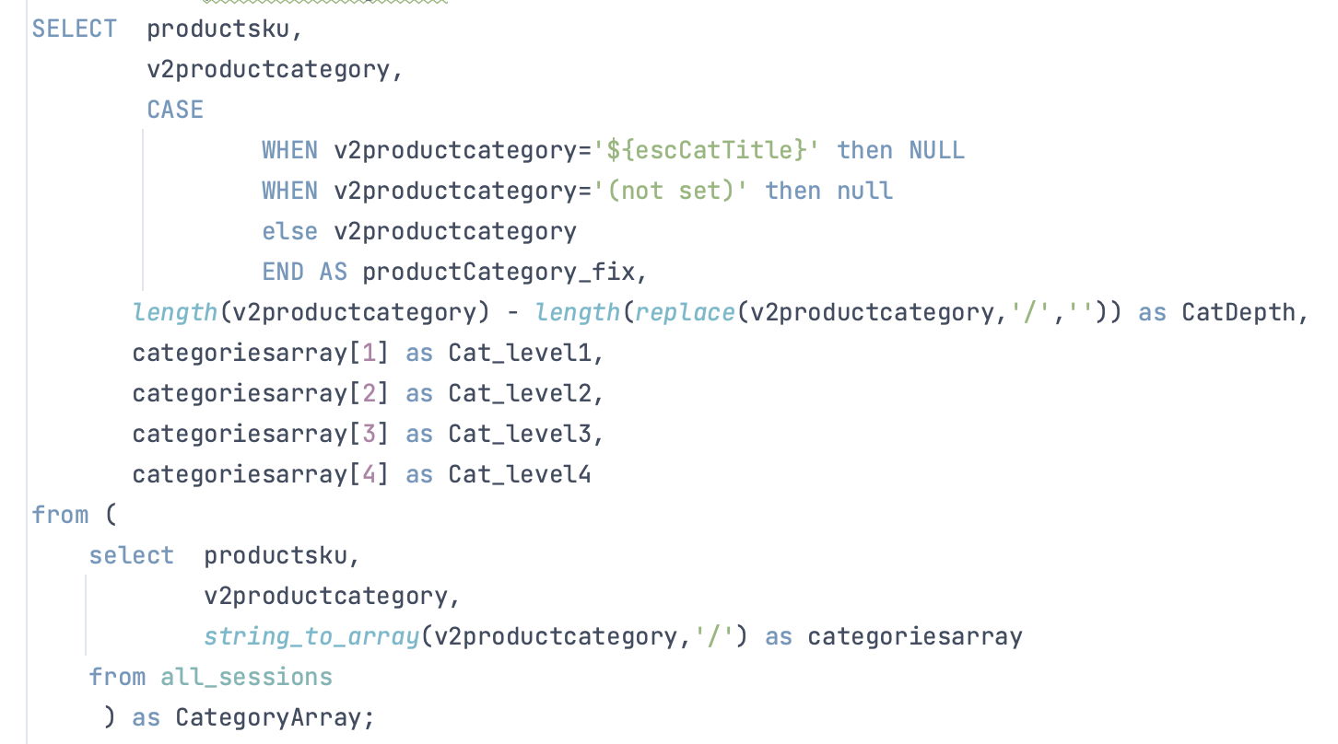
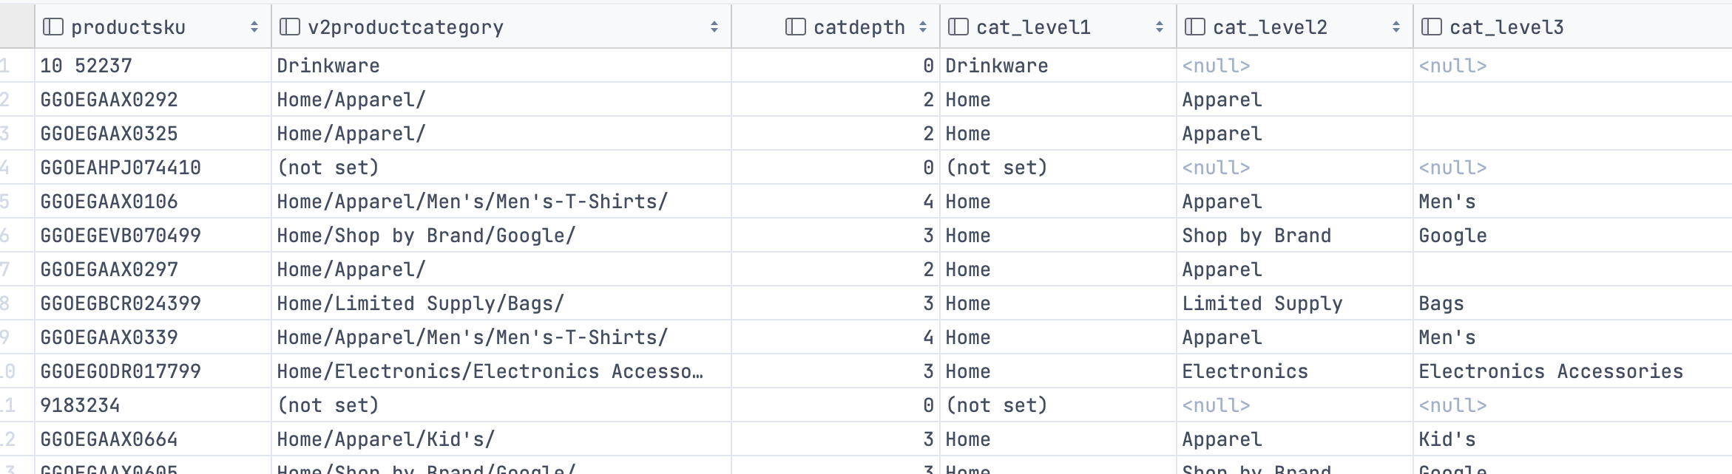
Thank you
The one part I’m happy with >>

